Slide 1



LOOK BACK 3
Part 3

Slide 2
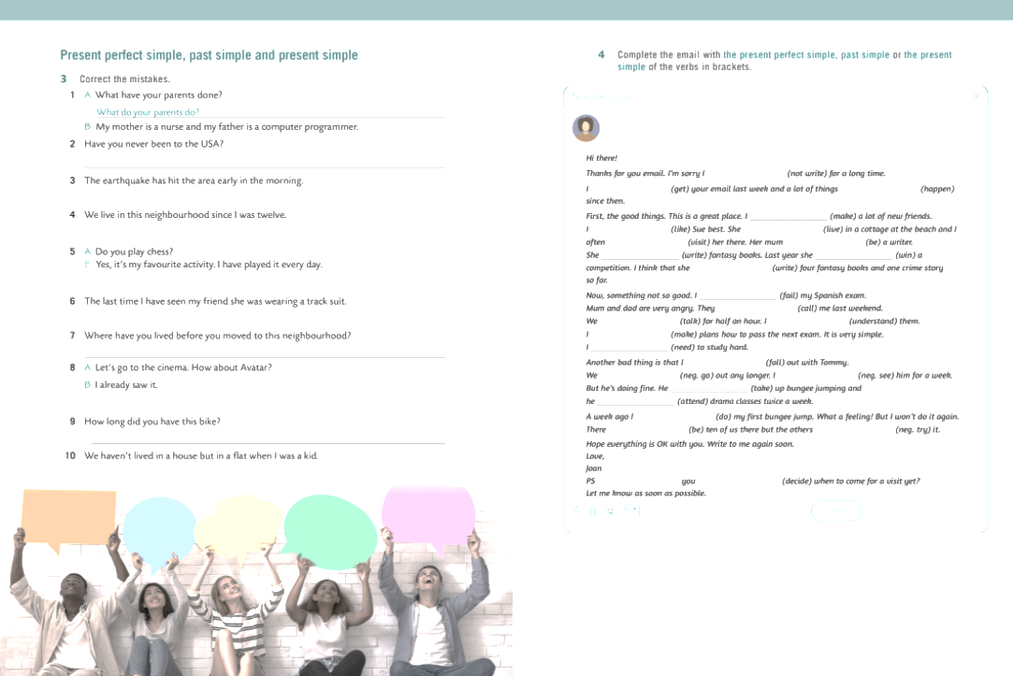
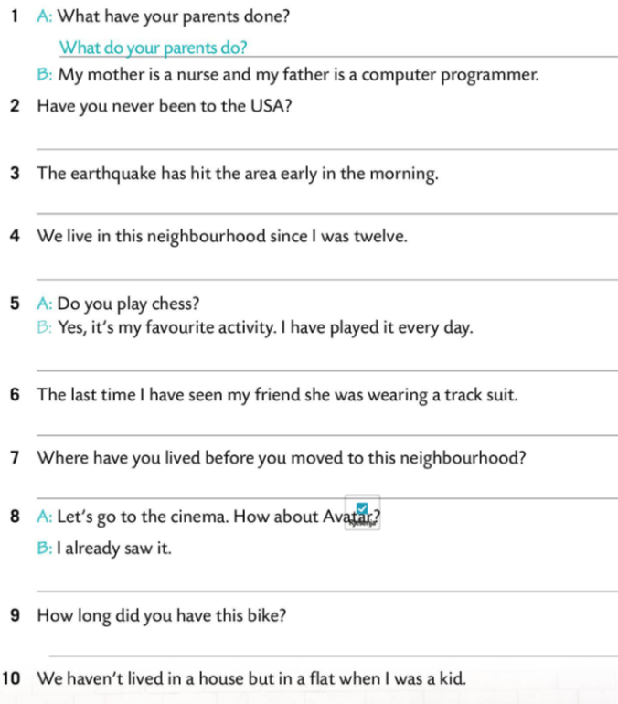

Have you ever been to the USA ?
The earthquake hit the area early in the morning.
We have been living/have lived in this neighbourhood since I was twelve.
I play it every day.
The last time I saw my friend she was wearing a track suit.
Where did you live before you moved to this neighbourhood?
I have already seen it.
How long have you had this bike?
We didn’t live in a house but in a flat when I was a kid.

Slide 3

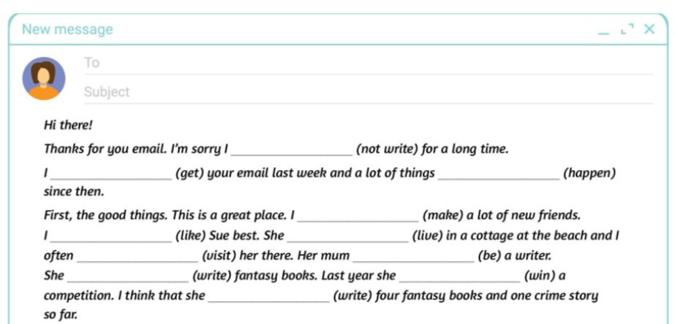
haven’t written
got
have happened
have made
like
lives
visit
is
writes
won
has written

Slide 4
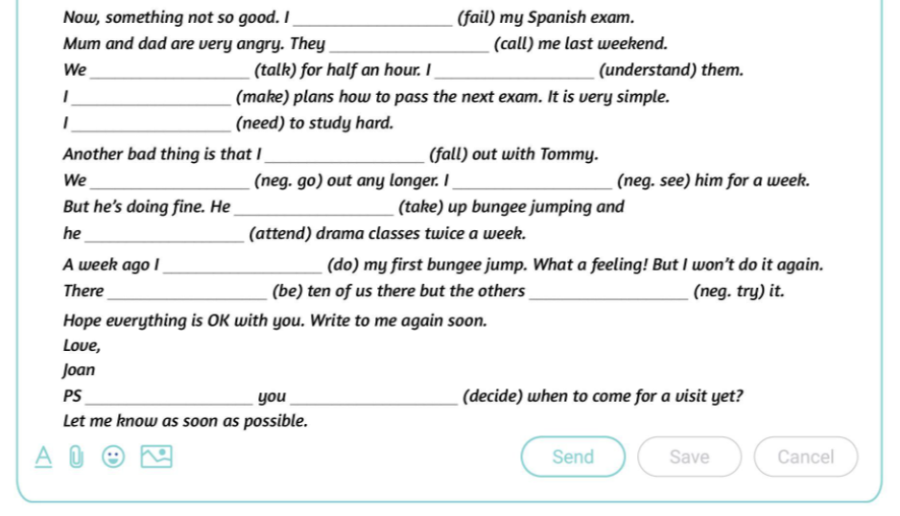

have failed
called
talked
understand
have made / am making
need
have fallen
don’t go
haven’t seen
has taken
attends
did
were
didn’t try
have
decided

Slide 5
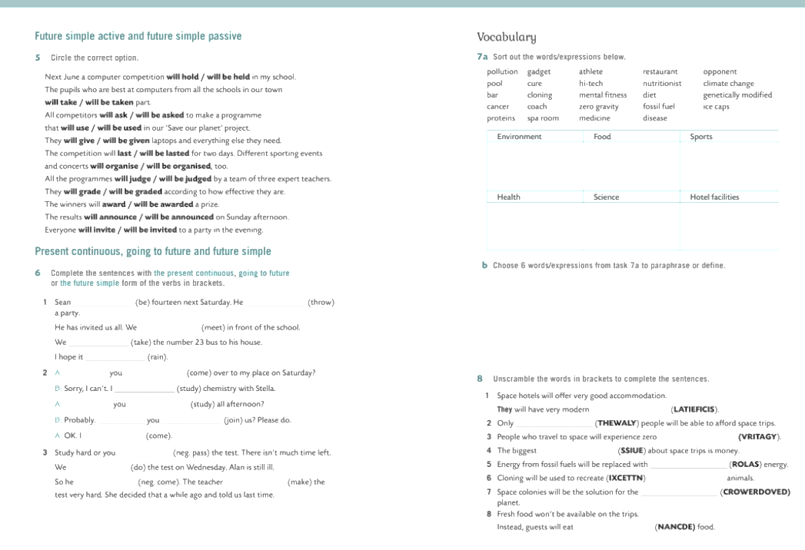
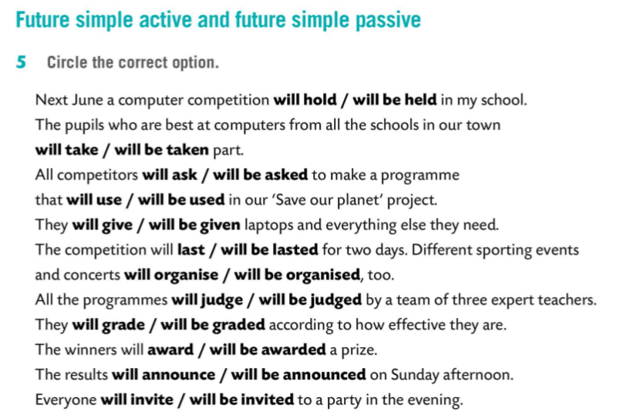


Slide 6
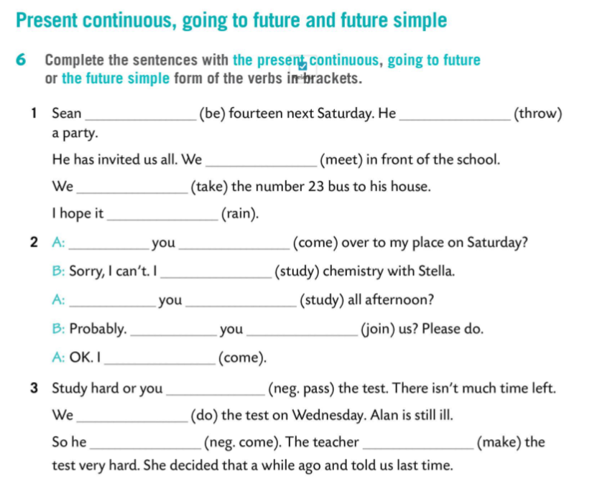

will be
is going to throw
are going to meet / are meeting
will take
won’t rain
will / are
come / coming
am studying
Are
going to study
Will
join
will come
won’t pass
are doing
won’t come
is going to make

Slide 7
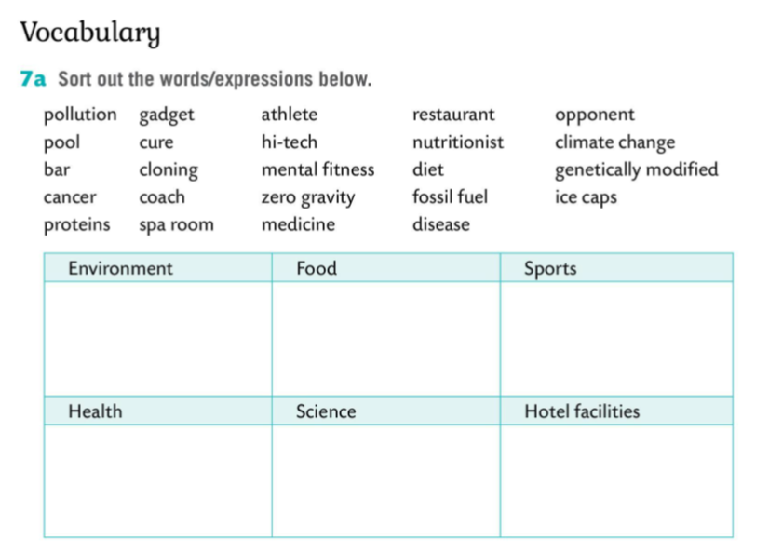
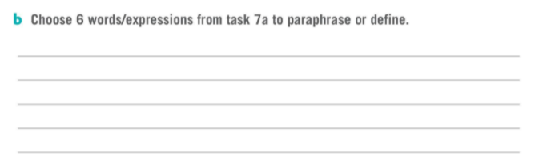
pollution
fossil fuel
nutritionist
athlete
opponent
climate change
genetically modified
mental fitness
ice caps
diet
proteins
coach
cure
cancer
hi-tech
restaurants
pools
gadgets
spa rooms
medicine
zero gravity
disease
cloning
bars

Slide 8
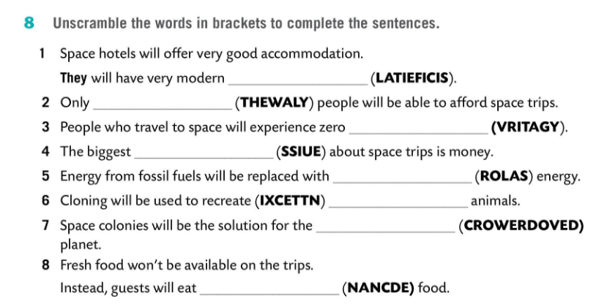

facilities
wealthy
gravity
issue
solar
extinct
overcrowded
canned

